Slide 1

Varendra University
Dept. of Computer Science & Engineering (CSE)
Lab 5
Course Title: Microprocessor and Assembly Language Lab
Course No: CSE 3206
Prepared By:
Md. Adnan Sami
Lecturer, Dept. of CSE, VU

Slide 2
Experiment No: 05
Name of the Experiment:
    Write an assembly language program to display 'o' if AL contains 1 or 3 and display 'e' if AL contains 2 or 4 using EMU8086.
    Write an assembly language program where a character is read and if it is an uppercase letter display it, otherwise terminate the program using EMU8086.

Slide 3
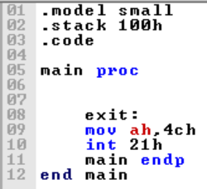
  Return

Slide 4
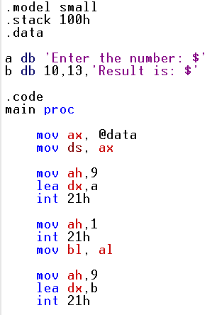
  1. Write some code in assembly language, if AL contains 1 or 3, display "o"; if AL contains 2 or 4, display "e" using EMU8086.

Slide 5
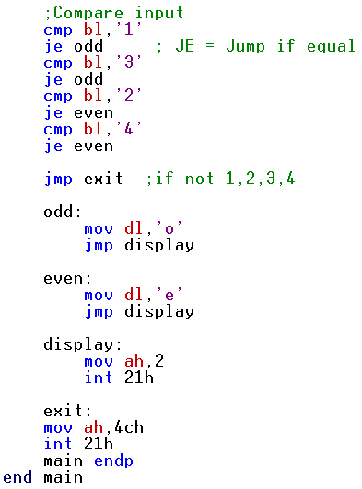
  1. Write some code in assembly language, if AL contains 1 or 3, display "o"; if AL contains 2 or 4, display "e" using EMU8086.

Slide 6
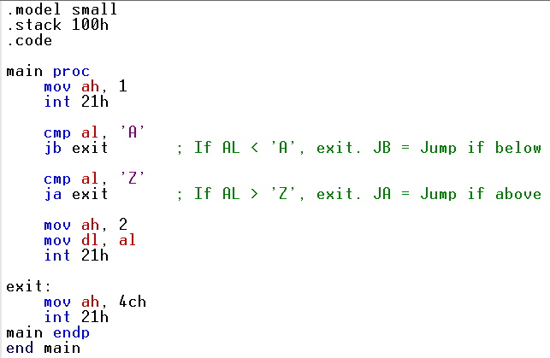
  2. Write an assembly language program where a character is read and if it is an uppercase letter display it, otherwise terminate the program using EMU8086.
Notes:
s

